Slide 1

6462A Integrating the Internet of Things with IBM Integration Bus
Peter Crocker IBM Internet of Things Foundation Product Manager crockerp@uk.ibm.com @petecrocker
John Hosie Product Architect - IBM Integration jhosie@uk.ibm.com @hosie31504

Slide 2
Benefits of real-time data from Internet of Things
Monetize | Charge for usage that is tracked by things Enable Pay-per-use models of things
Optimize | Improve efficiency of activities with data from things Anticipate & predict optimal actions and responses
Extend | Provide more value through connected things Deliver data, content, services through things
Control | Remotely affect behavior by controlling things Make remote adjustments to optimize things

Slide 3

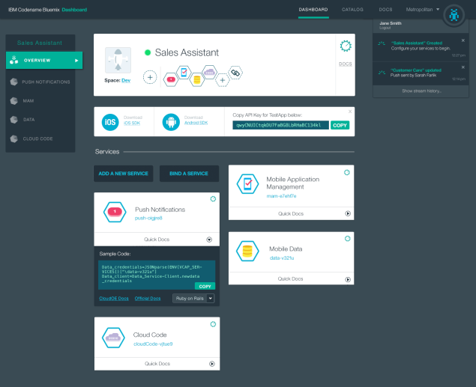

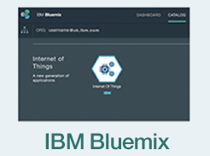
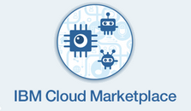














IBM Internet of Things Foundation
Start Internet of Things projects fast with low risk
IBM Internet of Things
Foundation
For C-Suite Executives & LOB looking to:
Extend the value of their assets or services by accessing the data available to their devices
Deliver new business models which monetize their assets in disruptive new ways such as pay-per use enabled through tracking
Optimize by understanding behaviour and anticipating most efficient actions
Remotely affect behaviour through the control of things
Why IBM? Implement on a platform agnostic to device vendor, scalable and secure with no claim over data ownership
Compose
For developers looking to:
Quickly, easily and securely bring data from an Internet-connected device into the cloud
Build an application alongside the device to collect the data and send real-time insights back to the developer’s business
Manage
Assemble
Collect
A Software as a Service offering available in:
Connect

Slide 4
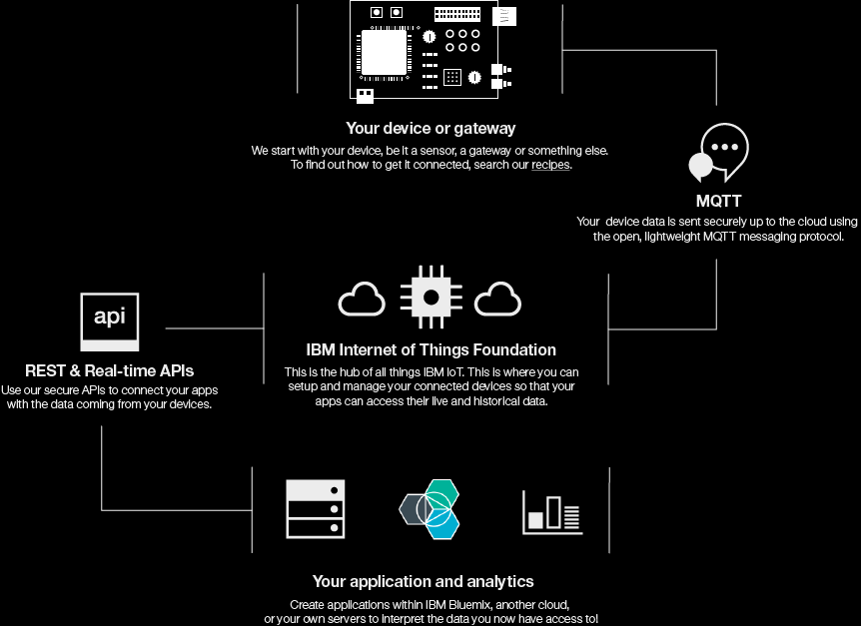
IBM IoT Foundation
Connectivity Summary
IBM Internet of Things
Foundation

Slide 5
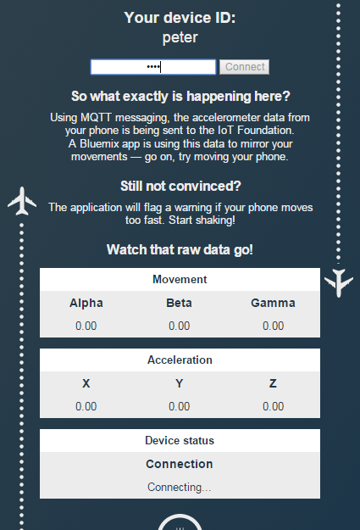
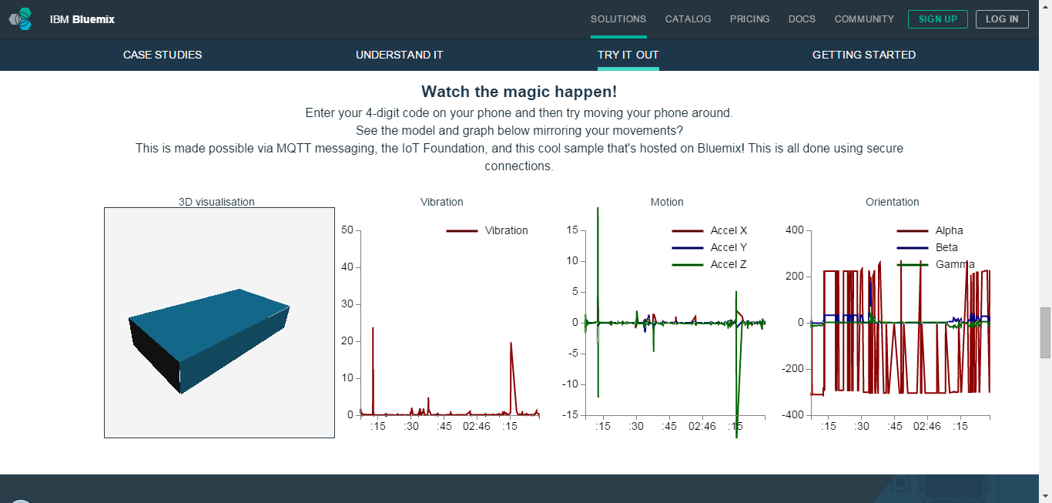
Bluemix IoT Zone
https://bluemix.net/solutions/iot

Slide 6
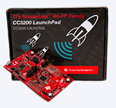
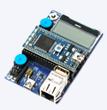
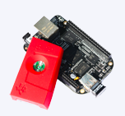


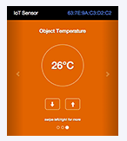
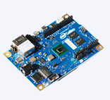
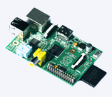
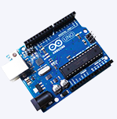




Quickstart comes with recipes and code for the following and more…
IBM Internet of Things
Foundation
Explore the Recipes https://developer.ibm.com/iot/
with Wi-Fi Shield

Slide 7




Reliably and quickly deliver IoT data with MQTT
Open royalty free spec
Wide variety of clients and servers
Hobbyist to enterprise
Open source to commercial
MQTT
Open
Lean
Simple
Reliable
Minimized on-the-wire format
Smallest packet size 2 bytes
Scalable
Low footprint
Clients: C=30Kb; Java=100Kb
Minimal pub/sub messaging semantics
Asynchronous (“push”) delivery
Simple set of verbs -- connect, publish, subscribe and disconnect
Three qualities of service
0 – at most once delivery
1 – assured delivery dups ok
2 – once and once only delivery
Copes with loss of contact between client and server.
“Last will and testament” to publish a message if the client goes offline.
MQTT 3.11 now Oasis Standard

Slide 8
Simple Client code to connect
JavaScript API example
Connect
function connect(form) {
try {
client = new Messaging.Client(hostName, port, clientId);
} catch (exception) {
alert("Exception:"+exception);
}
client.onMessageArrived = onMessageArrived;
client.onConnectionLost = connectionLostCallback;
client.connect({onSuccess: onSuccessCallback});
}
Create client
Set callbacks
Connect to the server
Subscribe
function subscribe(form) {
client.subscribe(form.subscribeTopicName.value);
}
Subscribe to
A topic
function doSend(form) {
if (form.textMessage.value == "") {
message = new Messaging.Message("");
} else {
message = new Messaging.Message(form.textMessage.value);
}
message.destinationName = form.topicName.value;
client.send(message);
}
Create Message object
Publish
Set Topic
Send the
message
function onMessageArrived(message) {
var form = document.getElementById("basic");
form.receivedMessage.value = message.payloadString;
}
Show the payload in a field
Receive
7

Slide 9

Demo Scenario
Optimising the utilisation of assets through predictive maintenance

Slide 10
Demo Scenario
Bus spends most of the time on the road
Optimising the utilisation of assets through predictive maintenance

Slide 11
Demo Scenario
Bus spends most of the time on the road
Mechanic in local depot needs to replace parts occasionally
Optimising the utilisation of assets through predictive maintenance

Slide 12
Demo Scenario
Bus spends most of the time on the road
Asset record stores vehicle service history
Mechanic in local depot needs to replace parts occasionally
Optimising the utilisation of assets through predictive maintenance

Slide 13
Demo Scenario
Bus spends most of the time on the road
Asset record stores vehicle service history
Mechanic in local depot needs to replace parts occasionally
spare parts delivered from national warehouse when required
Optimising the utilisation of assets through predictive maintenance

Slide 14









Demo Scenario
Constant stream of data from bus
Insignificant events are ignored
Service records are checked
Part replacement scheduled in local depot
Order sent to warehouse
for part delivery
Optimising the utilisation of assets through predictive maintenance

Slide 15
Demo Architecture
MQTT
HTTP
File (CSV)
SAP

Slide 16
Demo Architecture
IBM IoT Foundation
HTTP
JSON
JSON or XML
IBM Integration Bus
CSV
IDOC
File
SAP

Slide 17
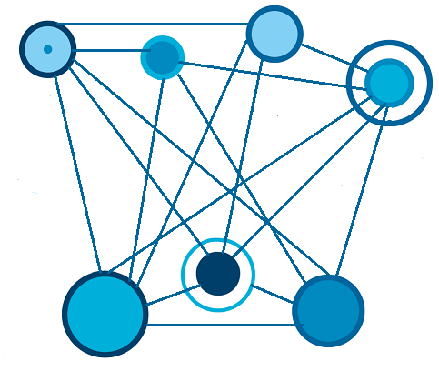

Introducing IBM Integration Bus
IBM Integration Bus
Provides heterogeneous connectivity across enterprise systems, applications and data
Connect
Transform
Route
Monitor
…
Notes:
Enterprise systems consist of many logical endpoints
Off-the-shelf applications, services, packaged applications (SAP, Siebel etc.) Web applications, devices, appliances, custom built software and many more!
Endpoints expose a set of inputs and outputs, which comprise:
Protocols such as MQ, TCP/IP, database, HTTP, files, FTP, SMTP, POP3. Formats like (C/COBOL), XML, industry (SWIFT, EDI, HL7), user-defined
Point-to-point connections quickly deteriorate into spaghetti
Inflexible architecture which is expensive to maintain and resistant to change
IBM Integration Bus connects these endpoints in meaningful ways
Avoids rewrites in response to new integration requirements
Simplifies maintenance by reducing expensive coupling
Flexibility adding anonymity between producers and consumers of data
Adds insight into applications and business value they bring

Slide 18
Demo Scenario – Data flow
Current millage
Vehicle Identification Number
License plate
Millage is multiple of 1000
Current mileage
Vehicle Identification Number
License plate
Current fitted parts
Millage when fitted
service limit
SKU
Current millage
Vehicle Identification Number
License plate
Replacement part SKU
Ordered part SKU

Slide 19
Where do I go to find out more?
Internet of Things Foundation: https://internetofthings.ibmcloud.com/
Explore the Recipes https://developer.ibm.com/iot/
Bluemix IoT Zone https://bluemix.net/solutions/iot
IBM Integration Community https://developer.ibm.com/integration
IBM Integration Bus Open Beta https://ibm.biz/iibopenbeta
Follow us on Twitter @IBMIoT

Slide 20
Notices and Disclaimers
Copyright © 2015 by International Business Machines Corporation (IBM). No part of this document may be reproduced or transmitted in any form without written permission from IBM.
U.S. Government Users Restricted Rights - Use, duplication or disclosure restricted by GSA ADP Schedule Contract with IBM.
Information in these presentations (including information relating to products that have not yet been announced by IBM) has been reviewed for accuracy as of the date of initial publication and could include unintentional technical or typographical errors. IBM shall have no responsibility to update this information. THIS document is distributed "AS IS" without any warranty, either express or implied. In no event shall IBM be liable for any damage arising from the use of this information, including but not limited to, loss of data, business interruption, loss of profit or loss of opportunity. IBM products and services are warranted according to the terms and conditions of the agreements under which they are provided.
Any statements regarding IBM's future direction, intent or product plans are subject to change or withdrawal without notice.
Performance data contained herein was generally obtained in a controlled, isolated environments. Customer examples are presented as illustrations of how those customers have used IBM products and the results they may have achieved. Actual performance, cost, savings or other results in other operating environments may vary.
References in this document to IBM products, programs, or services does not imply that IBM intends to make such products, programs or services available in all countries in which IBM operates or does business.
Workshops, sessions and associated materials may have been prepared by independent session speakers, and do not necessarily reflect the views of IBM. All materials and discussions are provided for informational purposes only, and are neither intended to, nor shall constitute legal or other guidance or advice to any individual participant or their specific situation.
It is the customer’s responsibility to insure its own compliance with legal requirements and to obtain advice of competent legal counsel as to the identification and interpretation of any relevant laws and regulatory requirements that may affect the customer’s business and any actions the customer may need to take to comply with such laws. IBM does not provide legal advice or represent or warrant that its services or products will ensure that the customer is in compliance with any law.

Slide 21
Notices and Disclaimers (con’t)
Information concerning non-IBM products was obtained from the suppliers of those products, their published announcements or other publicly available sources. IBM has not tested those products in connection with this publication and cannot confirm the accuracy of performance, compatibility or any other claims related to non-IBM products. Questions on the capabilities of non-IBM products should be addressed to the suppliers of those products. IBM does not warrant the quality of any third-party products, or the ability of any such third-party products to interoperate with IBM’s products. IBM expressly disclaims all warranties, expressed or implied, including but not limited to, the implied warranties of merchantability and fitness for a particular purpose.
The provision of the information contained herein is not intended to, and does not, grant any right or license under any IBM patents, copyrights, trademarks or other intellectual property right.
IBM, the IBM logo, ibm.com, Bluemix, Blueworks Live, CICS, Clearcase, DOORS®, Enterprise Document Management System™, Global Business Services ®, Global Technology Services ®, Information on Demand, ILOG, Maximo®, MQIntegrator®, MQSeries®, Netcool®, OMEGAMON, OpenPower, PureAnalytics™, PureApplication®, pureCluster™, PureCoverage®, PureData®, PureExperience®, PureFlex®, pureQuery®, pureScale®, PureSystems®, QRadar®, Rational®, Rhapsody®, SoDA, SPSS, StoredIQ, Tivoli®, Trusteer®, urban{code}®, Watson, WebSphere®, Worklight®, X-Force® and System z® Z/OS, are trademarks of International Business Machines Corporation, registered in many jurisdictions worldwide. Other product and service names might be trademarks of IBM or other companies. A current list of IBM trademarks is available on the Web at "Copyright and trademark information" at: www.ibm.com/legal/copytrade.shtml.

Slide 22
Thank You
Your Feedback is Important!
Access the InterConnect 2015 Conference CONNECT Attendee Portal to complete your session surveys from your smartphone,
laptop or conference kiosk.

Slide 23
Background

Slide 24
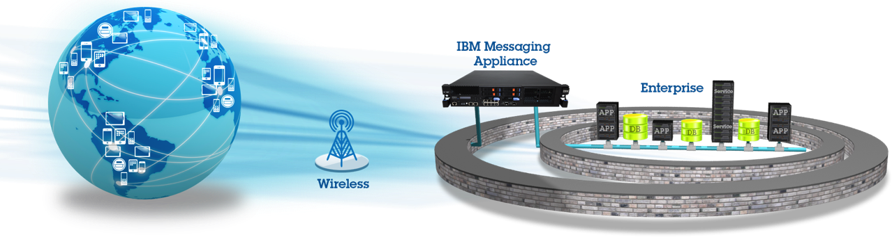


IBM MessageSight
Extends IBM’s Messaging leadership to the Internet for mobile applications and the Internet of Things
Optimized to reduce data costs, power requirements and operational costs while being a better/faster user experience to the mobile application and device worlds
IBM’s proven OpEx-saving appliance form factor
Based on open standards
Optimized connectivity for Mobile Applications and devices Efficient open protocol Event-driven responsiveness Open and industry agnostic Fine-grained security policies | Active dev community Free dev virtual appliance Simple yet powerful APIs Quick ramp messaging paradigm 40+ MQTT clients for all platforms | Up and running < 30 minutes Task oriented web-based UI Designed to be operated in the data center with the skills of personnel who operate routers and other network gear
Hardened Appliance Form Factor driven by secure firmware that can’t be tampered No user-visible OS Can’t be compromised by 3rd-party code Much more inexpensive to maintain than servers | JMS WebSockets MQ Integration Bus Worklight InfoSphere Streams Workload balancing across Application Servers | 13M non-persistent msg/sec 400K persistent msg/sec 1M concurrent connections Predictable microsecond latency under load Highly available
Designed for Mobile Apps and Devices
Developer
Friendly
Reduce OpEx Costs
Proven IBM Appliance Platform
Integrates
Internet
Scale
Notes:
IBM MessageSight is designed to bring bi-directionally interactive and secure messaging to mobile applications and devices while maintaining a simple to deploy proven IBM appliance form factor.
One of the most important aspects of the IBM appliance form factor is its ability to be operated in the data center with the same low operational skill level as required to operate routers and other network gear. Acquisition cost is only a small portion of a product’s TCO and IBM appliances are specifically designed to save you money in the most costly area of the IT product lifecycle: Ongoing OpEx costs.
Data from IBM customers shows that IBM appliances can be 7X+ less expensive to operate in the data center than alternative solutions that are software on servers.

Slide 25


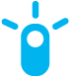
IoT drives Industry
 | Banking | Healthcare | Automotive | Retail | Transport | E&U
Monetize | Cash replacement solutions Mobile banking | Paid home care family services | Pay-per-drive car rental | Cash replacement Sensor-enabled loyalty cards | Paid alerts to travellers Congestion charging | Pay-per-use energy
Optimize | Optimized cash management | ER bed resource mgmt | Component predictive replacement Fleet mgmt | Delivery and stock replenishment optimization Store layout optimization | Smart Cities Traffic mgmt Airport Management | Delay non-essential supply during peak loads
Extend | Banking the un-banked Biometrics Smarter Subsidies | Life style monitoring | In-car Movies, Music, Games Highly Automated Driving | Smart Vending Machines Delivery Lockers | Mobility Services | Smart home services
Control | Remote ATM management Dynamic Authorization | Remote hospital environment Mgmt | Remote drive-train optimization | Store energy mgmt Store parking mgmt Dynamic price labels | Crowd mgmt Timetable mgmt Asset mgmt | Remotely control consumer devices
$
$
$
Notes:
Banking
Monetize: Cash replacement solutions like Smart Cards, NFC enabled mobile wallets - used for mobile money, mobile payments facilitating cash less transactions. Mobile Banking - core banking transactions done using the mobile phone.
Optimize: Optimized Cash Management - Channel Integration and analytics helping intelligent prediction of cash required at different channels like ATMs, Branches and bank's liquidity requirements.
Extend: Financial Inclusion by Banking the un-banked - Using hand-held or mobile devices to extend banking services to remote areas. Capturing bio-metrics as a means to identify individual in cases where required documents cannot be obtained for any reason.
Smarter Subsidies - Smart cards for those who get Government subsidies, which can be auto-remitted with the amount and can be used at PoS.
Control: Remote Management of ATMs - remote management including monitoring of cameras, battery banks, lighting systems, air-conditioners, door lock systems and generate real-time actionable information such as customer footprint patterns at an ATM. Can also generate alerts about the smoke, power outages, changes in room temperature, lighting etc. Fraud prevention using dynamic authorization/ card blocking - detecting a fraud condition when transactions happen at self service channels like ATM's and PoS based on some rules, sending a push notification on the phone seeking approval for the transaction and blocking the card in case of a denial.
Automotive
Monetize: pay-per-drive rental: The average car is used for 1 hr a day, enjoy the convenience of automatically paying for only the time you need to use a car.
Optimize: Component predictive replacement: Recognise changes in vehicle behaviour and identify components before they fail. Saving money and keeping vehicles on the road for longer.
Optimize: Fleet Management: Understand vehicle and driver performance to improve operating efficiency and reduce costs.
Extend Highly Automated Driving: Provide a safer and enhanced driving experience by making the vehicle aware of itself and the surrounding environment.
Control: Remote Drive-train optimization: Adjust a hybrid vehicle's balance of battery and petrol power for optimum efficiency ahead of time, by understanding the road ahead and environmental conditions.
Transport
Extend: Mobility Services: Seamlessly get from A to B using multiple modes of transportation, including public transport, bicycles, and car sharing.
Insurance
Monetize: Usage Based Insurance: Personalised Insurance based on what, where, when and how someone drives, allowing individual premiums to match an individual's risk.
E&U
Monetize: Pay-per-use-energy: Allow energy retailers to provide their customers with the ability to pre-purchase electricity and to use it how and when they choose.
Optimize: Delay non essential usage during peak load: Utility companies can manage their load demand by controlling supply to no essential requests.
Extend: Smart House Services: Home owners want the opportunity to have energy efficiency with the combination of controllable appliances and real-time access to energy usage data.
Control: Remotely control consumer devices: Home owners have the ability to monitor their appliances and change their status remotely.
Retail
RFID enabled loyalty cards. Enables cards to be detected without taking them out of the your bag/wallet, customer can collect points in store, in a restaurant etc. with out having to swipe it. Points are automatically added to loyalty account on payment. Allows retailer to know customer is in store and can react appropriately.
Delivery optimization Tracking of inventory using devices, RFID or other, so retailer knows where it is and when it is likely to arrive. Not only allows retailer to know where there stock is but to also change the destination if appropriate
Smart vending machines Use information from the vending machine to send to the owner so they can have the appropriate stock ready for refilling and to refill only when necessary. Can also be used for analytics to determine what stock is best in which location.
Inventory Management Devices on inventory not only allow retailers to know if items are being walked out of store without being purchased, but also to know where they are in the retail environment. For instance are they in the store's back depot when they should be on the shelves.
Control Alter dynamic pricing tags on shelving - this can be used in conjunction with analytics so that inventory which is either close to out of date or not selling can be marked down immediately, or conversely inventory that is likely to sell well (eg. weather dependent or suddenly trending) can be increased in price.

Slide 26



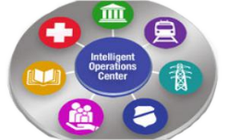


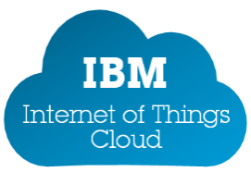


Internet of Things Ecosystem & Partners are crucial
IBM SWG
IBM Industry
Solutions
Streams
Maximo
IoC
SDK
SDK
Partnerships
MessageSight
Devices
Gateways
Networks
Clouds
Solutions & Applications
Oil
& Gas
Energy
& Utilities
Smarter
Cities
Consumer
Electronics
Connected
Vehicle
Transport
& Rail
Life Science
& Healthcare
Industrial
Manufacturing

